Slide 1


MTH208 Project
Team 24Group21
Project Guide : Dr. Dootika Vats
Team Members:
Anmol Gupta
Ankit Mal
Antriksh Sinku
Ankita Singh
The following website is being used to scrape the data:-
https://editorial.rottentomatoes.com/guide/best-netflix-shows-and-movies-to-binge-watch-now/

Slide 2


Slide 3
Objective
Analyze and visualize data on Netflix series using Rotten Tomatoes scores.
What are the highest-rated and most popular series
Facilitate Genre Comparisons: Highlight distinctions in score, seasonality, and engagement across genres.
What trends emerge from user reviews, and what do people commonly like or dislike

Slide 4

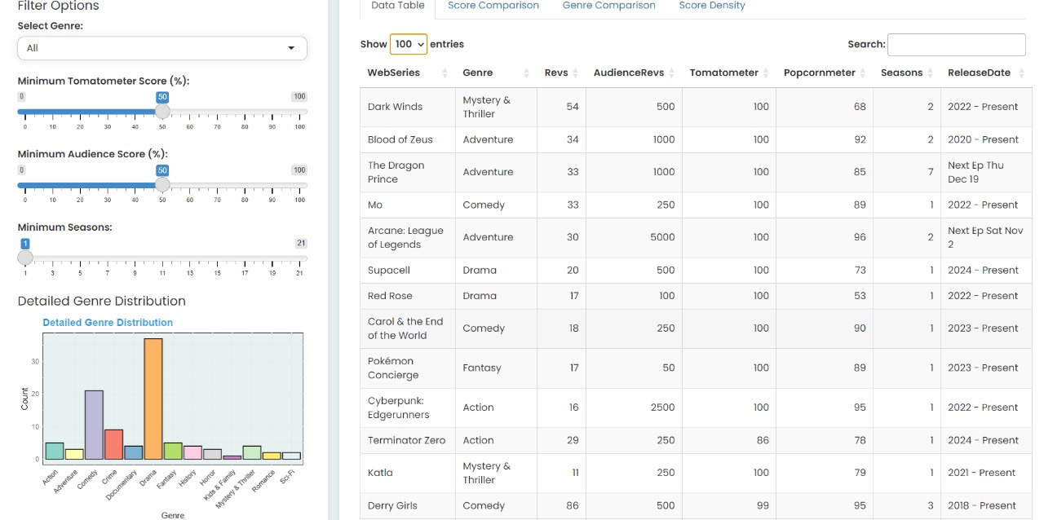

Allows users to filter series based on genre, critic score (Tomatometer), audience score (Popcornmeter), and the number of seasons.

Slide 5

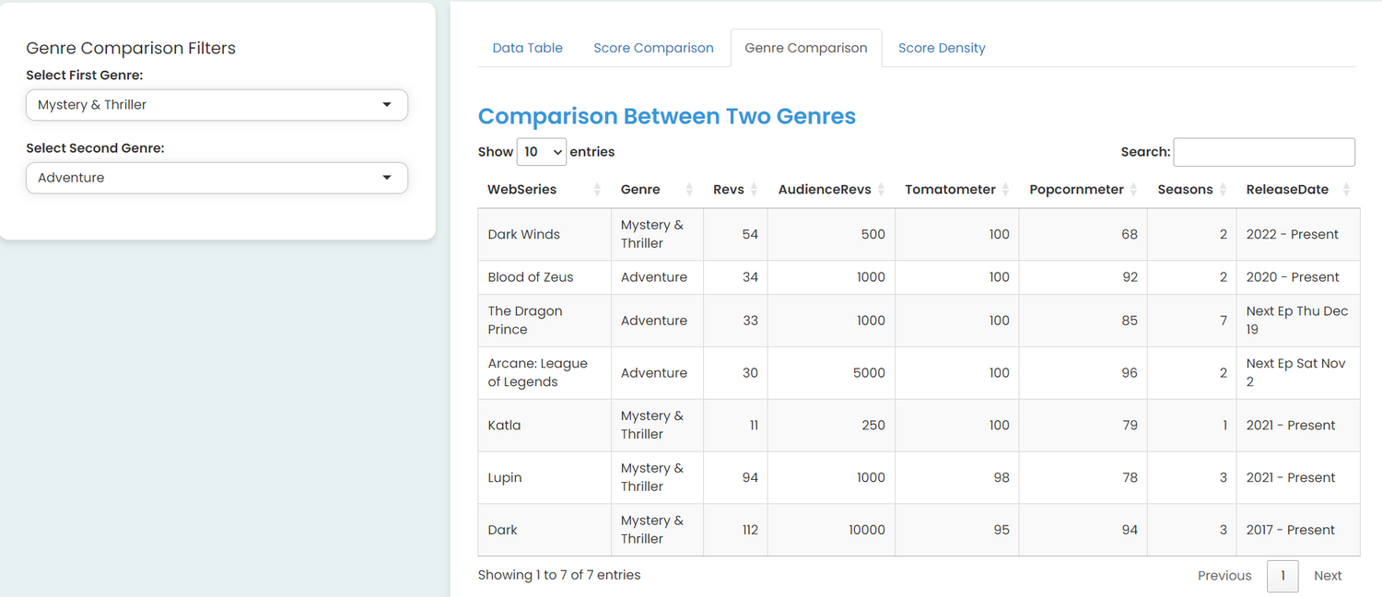
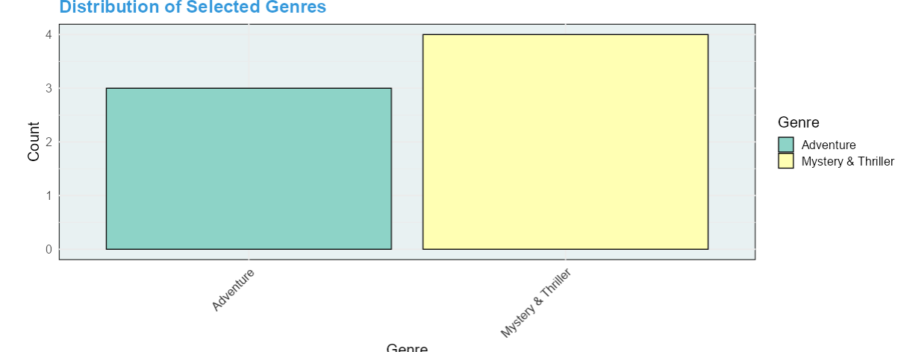
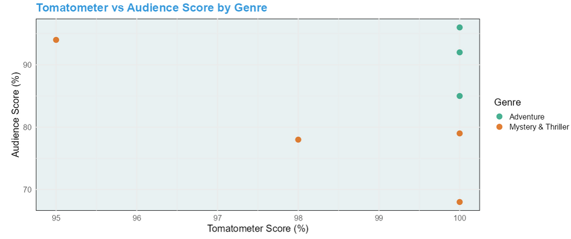

Enables comparison between two selected genres, providing both tabular data and visual distribution.

Slide 6

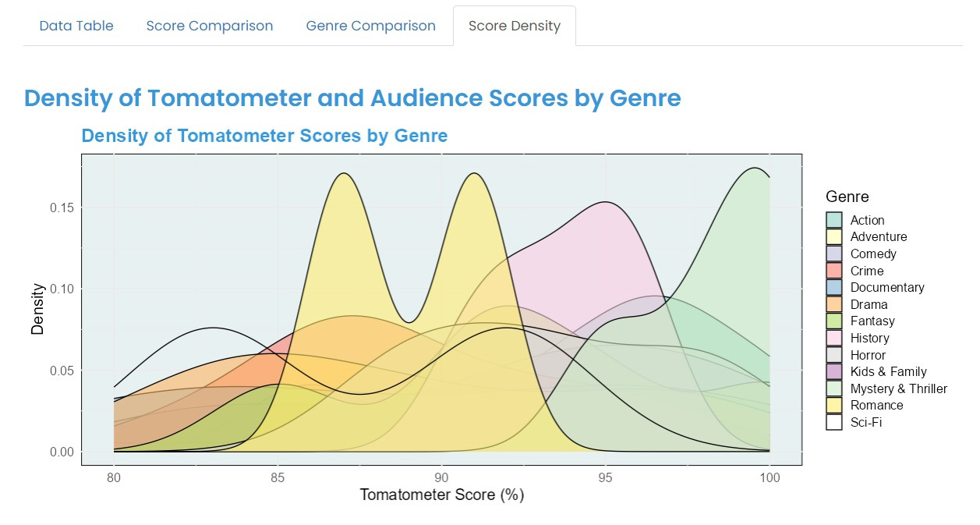
The Score Density Analysis shows how critic scores are distributed across genres
This helps users quickly compare critical reception between genres.

Slide 7
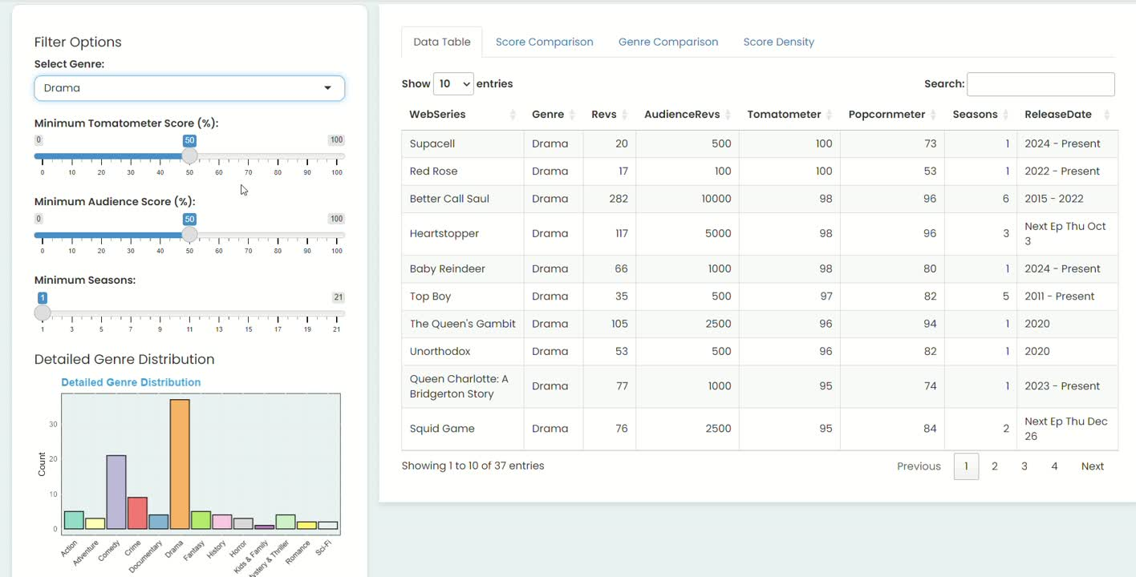

Slide 8

Thank you

